Slide 1
K.E.E.S.
Keyless Electronic Entry System
Group 17
Chris Condella, EE
Jason Wagner, CpE
Joshua Baxter, CpE
Samuel Demole, CpE
Notes:
add picture ?

Slide 2
Motivation
Home Automation is a trending technology in the commercial market
Improve on home monitoring and surveillance systems
Opportunity to learn and implement multiple hardware and software technologies

Slide 3
Goals and Objectives
Remote door access and guest management system
Remote control via web interface
Mobile app for real time communications
Enable multiple methods of entry to home
Allow specific guests access to home

Slide 4
Specs & Requirements
KEES camera module will display a live video feed with no less than 5s delay @ 30 FPS
KEES system will allow the user to save an image of the guest and add to the Face database
KEES system will allow for notifications via Text to be sent with no more than 5s delay
KEES service will listen for a request from the server when the doorbell is pressed and open the App with no more than 10s delay
KEES face recognition will recognize a guest within 3s
KEES RFID module will unlock door instantly upon scanning a valid RF tag from within 3in away
KEES piezoelectric sensor will recognize a custom knock within 3s
KEES system voltage and current will require 5V DC @ ~5A
KEES battery backup will last up to approx. 1-2hrs

Slide 5
Block Diagram
Knock Detector
Browser/App
MCU
SoC
RFID Reader
Server
Electric Strike
Power Supply
Camera
Mic/
Speaker
Notes:
Overview

Slide 6
State Diagram
Active
Locked
Waiting for Motion
Listen for Unlock request from WebApp
Face not
Recognized &
10 sec Timeout
Motion Detected
Attempt to Recognize Face
Listen for Door Bell
20 sec
Timeout
Face
Recognized
Door Bell
Pressed
Unlock
via WebApp
Listen for RFID /
Detect Knock Pattern
Listen for Unlock
Request from App
6 sec
Timeout
Valid
RFID
Valid
Knock Pattern
Unlock
via App
Door Unlocked

Slide 7
mcu
Knock Detector
Browser/App
MCU
SoC
RFID Reader
Server
Electric Strike
Power Supply
Camera
Mic/
Speaker
Notes:
Overview

Slide 8
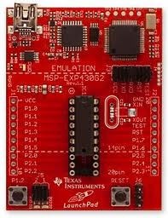
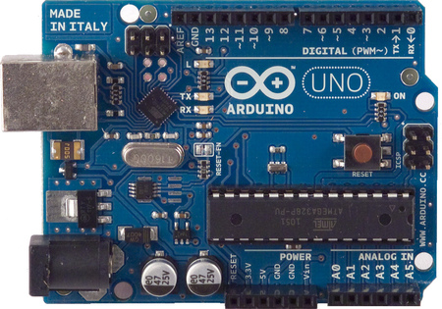
ATMega328 vs Msp430
 | ATMega328 | MSP430F2XX
CPU | 20MHz | 16 MHz
Flash Size | 16 KB | 1–120 KB
GPIO | 28 | 10-48
Power Req. | 3.3-5 V | 1.8-3.6 V

Slide 9
Electric strike
Knock Detector
Browser/App
MCU
SoC
RFID Reader
Server
Electric Strike
Power Supply
Camera
Mic/
Speaker
Notes:
Overview

Slide 10
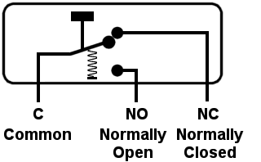
Types of electric strikes
Normally Closed (NC)
Strike is locked when no electric current is applied
Fail Secure
Normally Open (NO)
Strike is locked when electric current is applied
Fail Safe

Slide 11
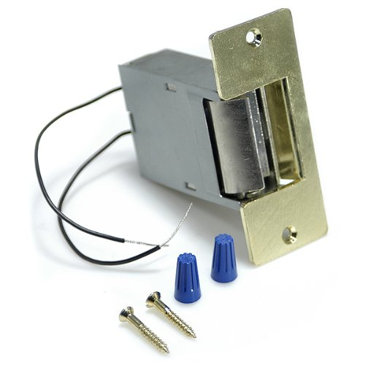
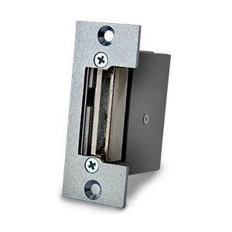
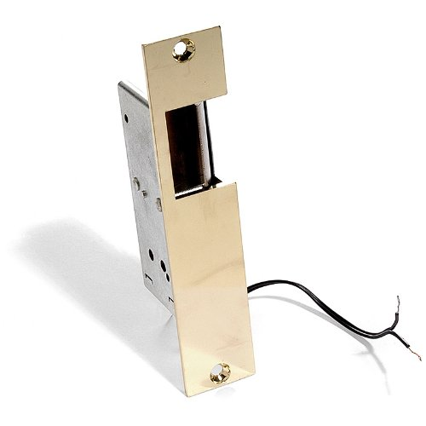
Electric strike
 | Lee Electric | Rutherford | Lee Electric
Voltage | 3-6 VDC | 12 VDC | 12VDC
Ohms | ~ 2.7 | 3.5 | 4
Current | ~1.8 A | ~3 A | ~2.5 A
Price | $40 | $50 | ~$33

Slide 12
LEE Electric Strike

Slide 13
Rfid module
Knock Detector
Browser/App
MCU
SoC
RFID Reader
Server
Electric Strike
Power Supply
Camera
Mic/
Speaker
Notes:
Overview

Slide 14
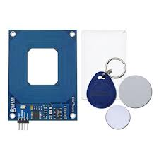
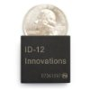
RFID MODULE comparison
Parallax
#28140
ID-Innovations
ID-12LA
 | Parallax | ID-12LA
Range | 1 ¾” - 3” inches | 3”- 5” inches
Frequency | 125 kHz | 125 kHz
Power Req. | +5 VDC | +2.8 VDC to +5 VDC

Slide 15
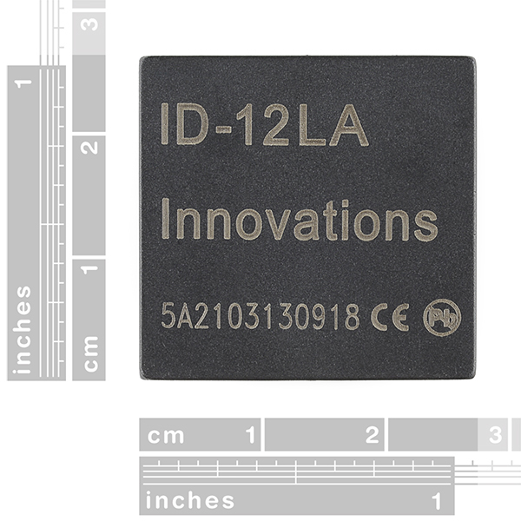
Rfid reader
Purpose:
Allow Entry through the door
Put system into Programming mode using MASTER key
Add/Remove RFID cards
EM4001 64-bit RFID card compatible
Parameter | ID-12LA
Frequency | 125 kHz nominal
Card Format | EM 4001 or compatible
Read Range ID12 | Up to 12cm
Encoding | Manchester 64-bit, modulus 64
Power Requirement | +2.8 VDC thru +5 VDC @ 35mA ID-12LA, 45mA ID-20LA
I/O Lines | 11
Price | $29.95

Slide 16
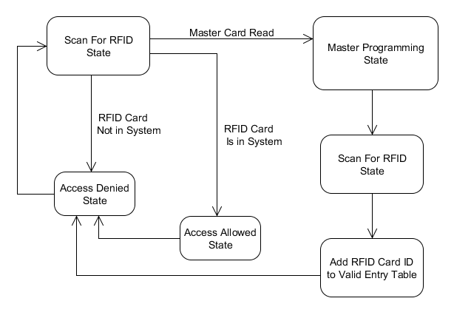
Rfid state diagram

Slide 17
Knock detector
Knock Detector
Browser/App
MCU
SoC
RFID Reader
Server
Electric Strike
Power Supply
Camera
Mic/
Speaker
Notes:
Overview

Slide 18
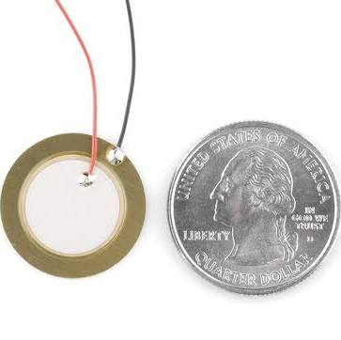
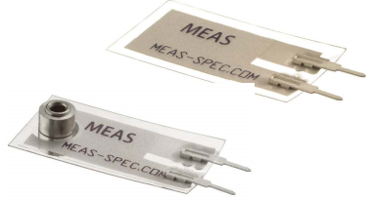
Piezo electric sensor
Purpose:
When Piezo material is deformed a charge is sent over terminals
Detect secret knock and allow entry through the door
Add/Remove Secret knocks

Slide 19
Knock detection state diag
Knock
Detected
Master Card
Swiped
Programming State
Storing Knock Parameter
Knock
Detected
Waiting for Knock
Storing Knock Parameter
Unlock Door
Validating Knock
Update Secret Knock

Slide 20
soc
Knock Detector
Browser/App
MCU
SoC
RFID Reader
Server
Electric Strike
Power Supply
Camera
Mic/
Speaker
Notes:
Overview

Slide 21
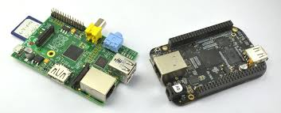
Beaglebone vs raspberry pi
 | BeagleBone Black | Raspberry Pi
Base Price | $45 | $35
Processor | 1GHz TI Sitara AM3359 ARM Cortex A8 | 700 MHz ARM1176JZFS
RAM | 512 MB DDR3L @ 400 MHz | 512 MB SDRAM @ 400 MHz
Storage | 2 GB on-board eMMC, MicroSD | SD
GPIO Capability | 65 Pins | 8 Pins
Peripherals | 1 USB Host, 1 Mini-USB Client, 1 10/100 Mbps Ethernet | 2 USB Hosts, 1 Micro-USB Power, 1 10/100 Mbps Ethernet, RPi camera connector

Slide 22
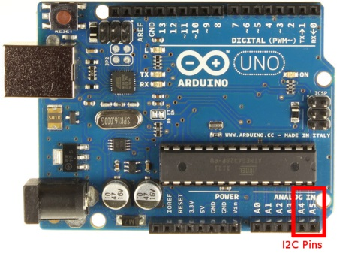

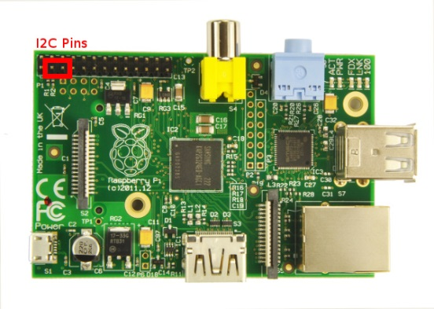
MCU – soc communication
Implementing I2C between ATMega and Pi
Character scripting protocol is sent over I2C bus for updating and control

Slide 23
mic/speaker
Knock Detector
Browser/App
MCU
SoC
RFID Reader
Server
Electric Strike
Power Supply
Camera
Mic/
Speaker
Notes:
Overview

Slide 24
Sound Input/Output
 | USB Sound Card | Microphone | Speaker
Company | Creative | HDE | Veho
Model | Sound Blaster Play! | Mini | VSS-001 360 M1
Features | Stereo 1x Speaker Out (3.5mm) 1x Mic in (3.55mm) 16-bit / 48kHz | Flexible 3.5mm Jack Sensitivity: -54±3dB Freq. Range: 100-5KHz | USB Powered 3.5mm Jack 2.4W Output Size: 50x50mm Weight: 4oz

Slide 25
Camera
Knock Detector
Browser/App
MCU
SoC
RFID Reader
Server
Electric Strike
Power Supply
Camera
Mic/
Speaker
Notes:
Overview

Slide 26
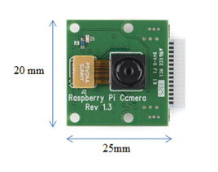
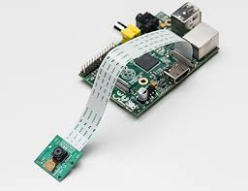
Raspberry Pi Camera
Supports wide range of video resolutions, up to 1080p
Connects via CSI on Raspberry Pi
Higher frame rate due to reduced latency: uses small amount of CPU
Webcams have higher latency

Slide 27
IMG Processing & streaming Features
Detect faces
Recognize specified faces
Save snapshot of a face in 320x240
Provide JPEG video stream viewable over the internet

Slide 28
IMG PROCESSING & Streaming
Raspistill
Driver captures frames from Raspberry Pi camera
Source code available
OpenCV 2.3
Face Recognition and Detection API
Optimized functions
Numerous image processing capabilities
MJPEG Streamer
Capture camera frames as .jpeg
Sends frames to a specified IP addresss
CMAKE

Slide 29
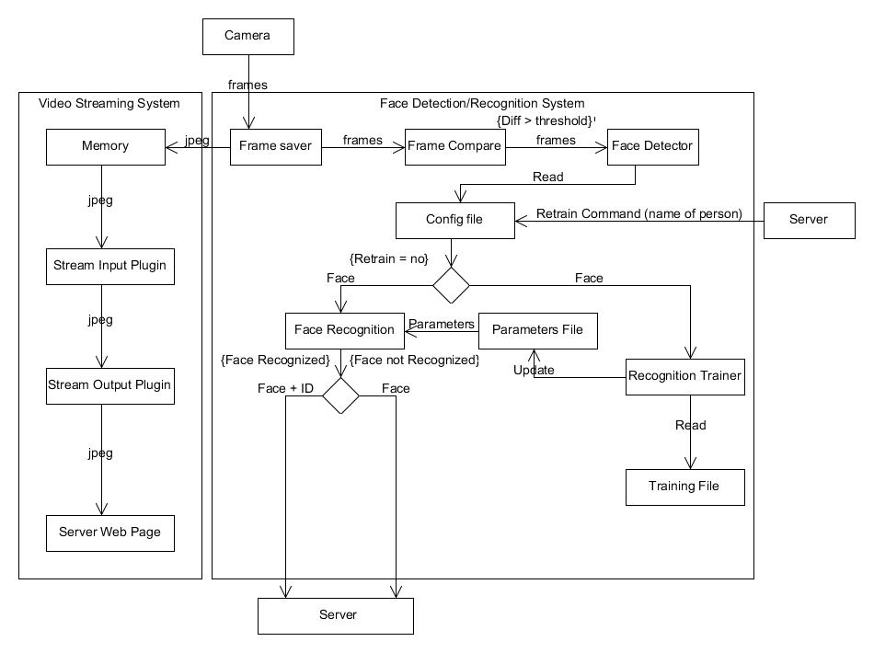
Img Processing & Streaming

Slide 30
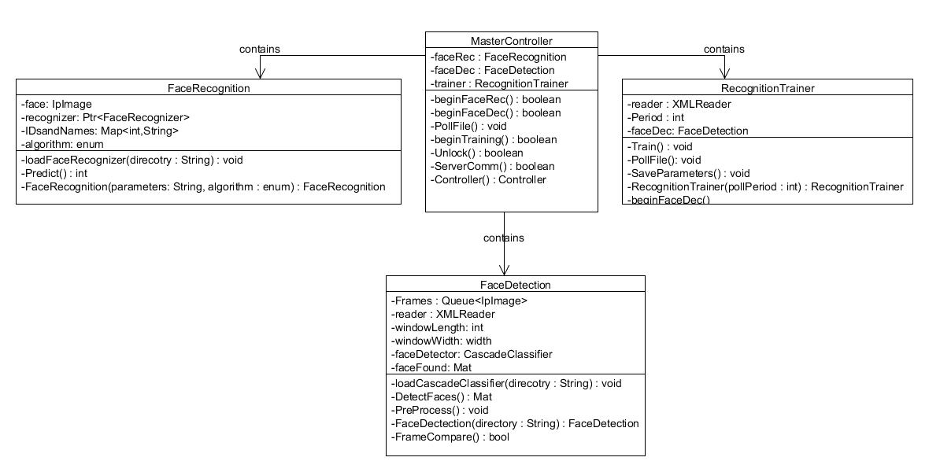
Img Processing Class Diagram

Slide 31
Server & App
Knock Detector
Browser/App
MCU
SoC
RFID Reader
Server
Electric Strike
Power Supply
Camera
Mic/
Speaker
Notes:
Overview

Slide 32
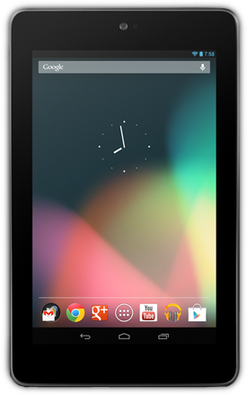
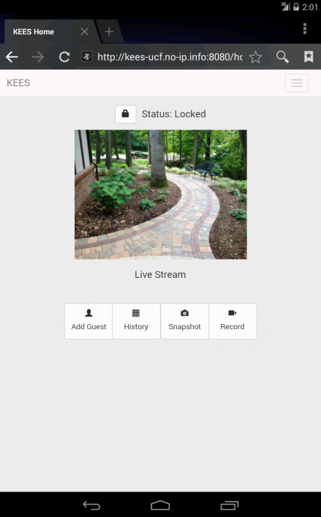
WebApp Features
Lock Status
Unlock Door
View Live Stream
View History
Snapshot/Record
Add/Manage Guests
Manage RFID
Manage Knock Patterns

Slide 33

WebApp (Frontend UI)
Bootstrap 3.0 framework
Responsive design
Numerous HTML/CSS templates
Cross-platform support
jQuery
Most popular JS library
Used by 65% of top 10,000 visited sites
HTML
CSS

Slide 34

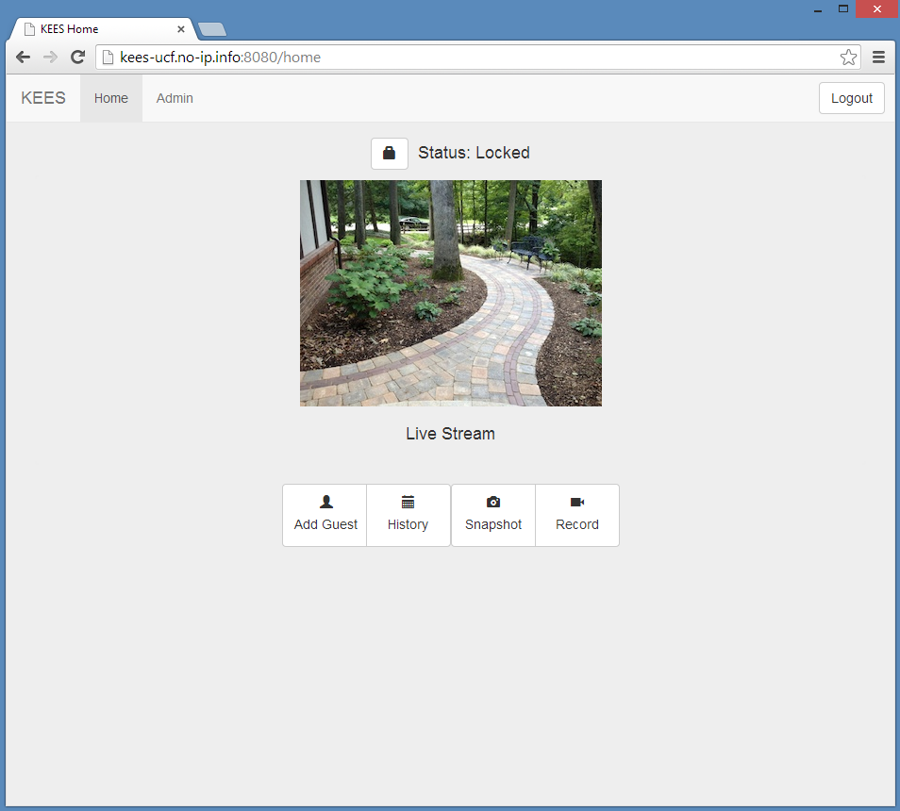
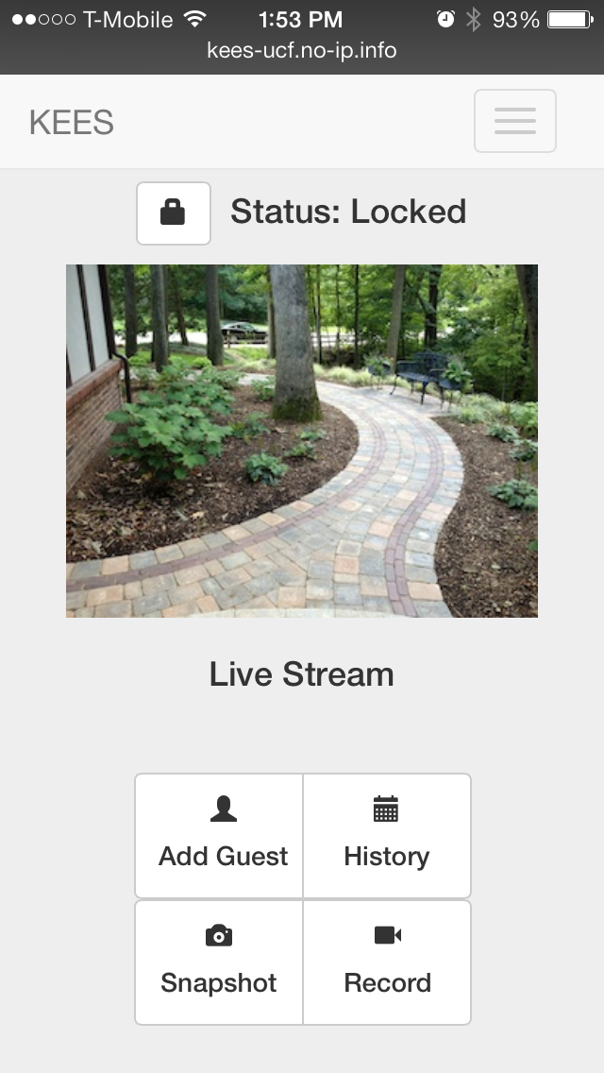
WebApp Responsive design

Slide 35
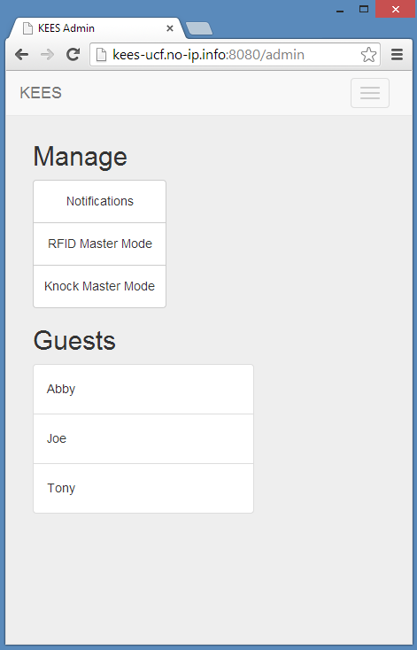
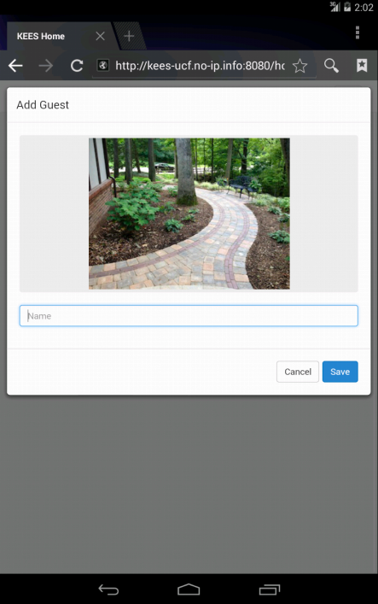
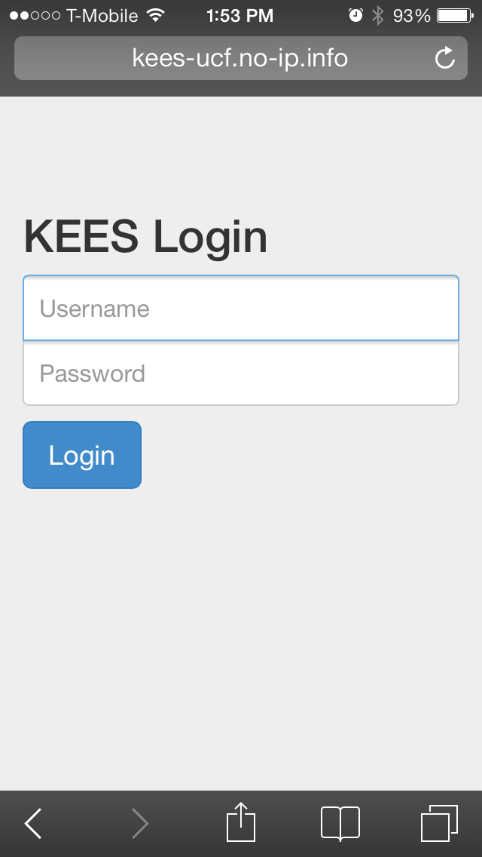
WebApp UI

Slide 36

WebApp (Backend)
Node.js - Webserver
express
jade
Mongoose
NPM - Node.js Package Manager
MongoDB - NoSQL Database
Admin Credentials
Event History
Guest Information
Git - Version Control
Twilio - Notification Service
MJPEG-Streamer
Python Scripts
Lock Control
RFID/Knock Master Control
Dynamic DNS (noip.com)

Slide 37
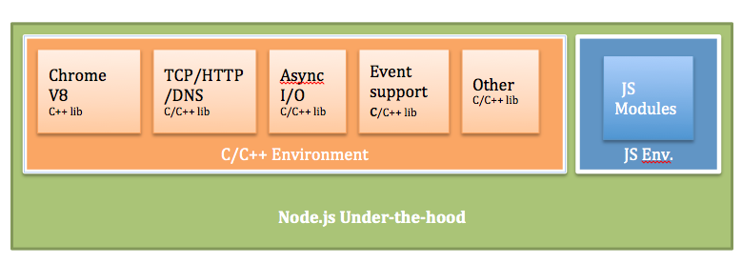
WebApp - Node.js
Single threaded, event-driven, non-blocking
High scalability
Lightweight
Pure JavaScript (No Apache/XML/PHP/MySQL)
Google V8 JavaScript Engine
Used by PayPal, Microsoft, LinkedIn, Yahoo!

Slide 38
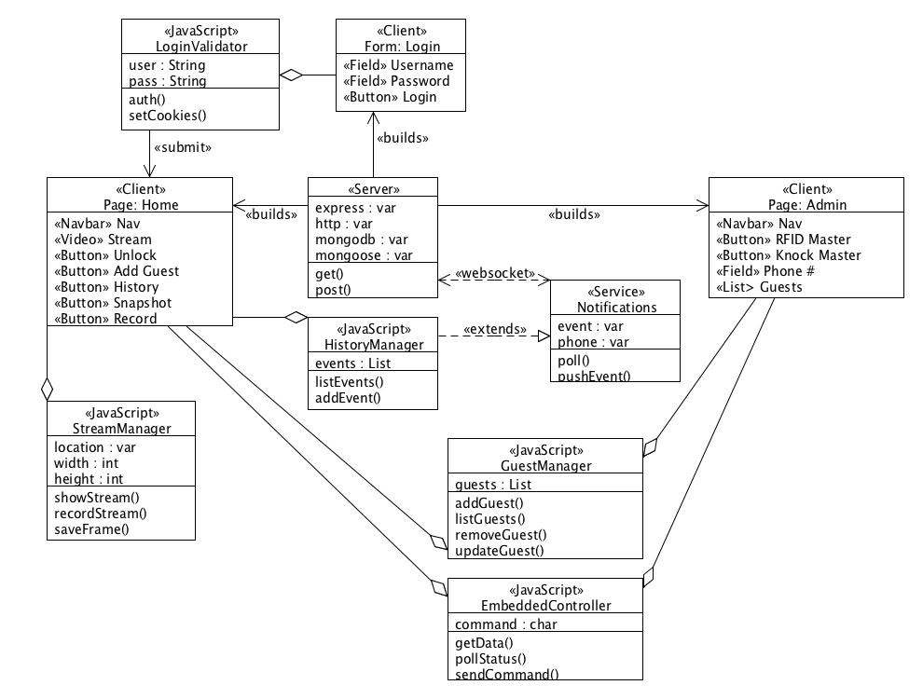
WebApp UML

Slide 39

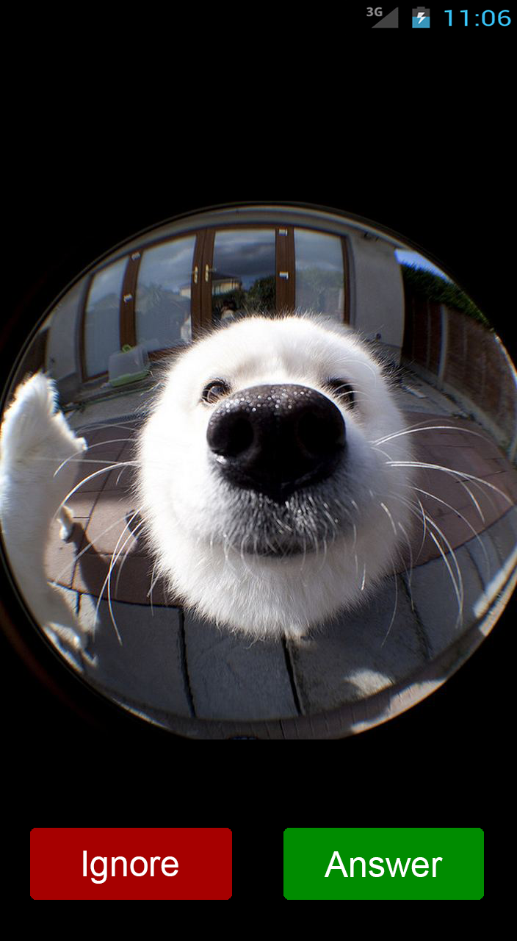

Android application
Service initialized upon door bell pressed
Provide remote communication with Guest
Similar to iOS FaceTime call
2-Way Audio, 1-Way Video
Door can be unlocked for Guest
Support for Android 4.0 and above
AudioRecord, Movie,
NotificationListenerService APIs

Slide 40
App / Door Bell Integration
Listener Service on RPi
(Python Script)
Door Bell Pressed
Request Sent to
Android Device
Listener on Android Device
App Initialized on Request
User can
Accept / Ignore
Serial Command Sent to MCU
Forward Unlock
Request to Server
Door Unlocked
User Accepts Communication with Guest
1. End Communication
2. Send Request to Unlock Door

Slide 41
Power
Knock Detector
Browser/App
MCU
SoC
RFID Reader
Server
Electric Strike
Power Supply
Camera
Mic/
Speaker
Notes:
Overview

Slide 42
Power Requirements
Component | Voltage Required | DC current Draw
Strike | 3-6 VDC | 1.1-2.2 A
RFID | 4.6-5.4 VDC | 30 mA
Atmega328 | 3.3/5 VDC | Per I/O pin ~40mA
 |  | VCC/GND pins ~200mA
Raspberry Pi | 5 VDC | 0.7 – 1 A
Charging Circuit | ~15 VDC | 0.2 - 1A
*The electric strike resistance ~ 2.7 Ω, using V=IR @ 5V, I = ~1.8 A
The entire system will need to be powered with 5VDC @ ~ 4 A or more to be safe. An AC/DC converter will be used to satisfy the 15V charging circuit and 5V regulator to step down the voltage.

Slide 43
Power Block Diagram
AC Power
15 V AC/DC Adapter
Battery Charger
Battery Pack
Diode OR
5V Regulator
System

Slide 44
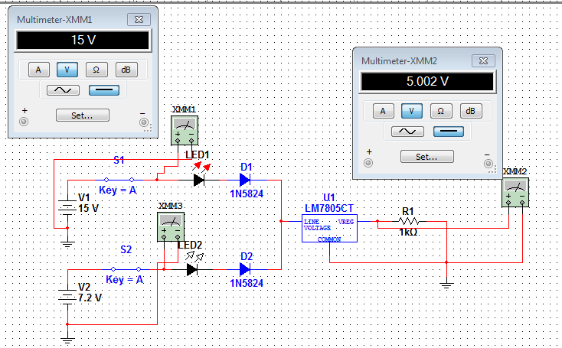
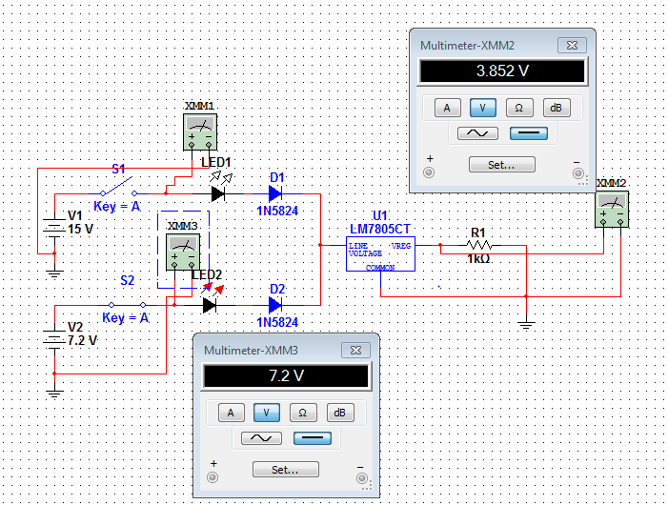
Diode OR-ing
When the 15 VDC source is ON it serves as the main power source for the load.
When the 12 VDC source
is OFF the back up 7.2 VDC source becomes the main power source for the load.

Slide 45
Device = LM5023MM-NOPB Topology = Flyback Vin = 100 – 240 VAC Vout = 15VDC Iout= 5A
AC/DC Converter
Designed with TI Webench

Slide 46
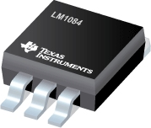


LM1084 5A Low Dropout Positive Regulator
5 VDC regulated
Max dropout of 1.5V
6.5V ≤ Vin ≤ 20V
5A of load current
Current Limiting (8A)
Thermal Protection
Vref ~ 1.25V
*Images from LM1084 pdf

Slide 47
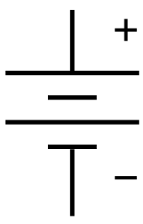
Battery back up
A battery back up will ensure the system will stay powered and active even if main power is lost.
Ideally battery would have an infinite amount of capacity for infinite back up.
1-2 hour back up should suffice for our project.
We will consider certain battery types and properties such as size, price, availability and convenience etc.

Slide 48
Battery types: rechargeable

Slide 49
Nimh Rechargeable AA Batteries
Charge Time (fully discharged)
(Batt mAh Capacity * 120%)/mA Charge Rate
= Hrs needed to charge
mA Charge Rate | Hrs of Charge
200 | ~43
400 | ~22
500 | ~17
600 | ~14
700 | ~12
900 | ~10
1000 | ~9
* From Energizer NiMH Handbook and App Manual PDF

Slide 50

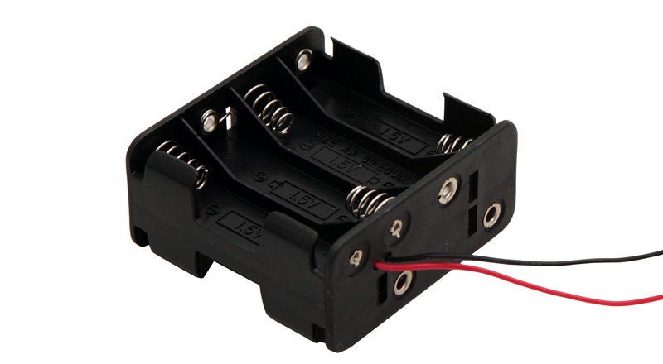
Float Charging circuit
# of NiMH Cells | Volts Required | R3 Ω | VR1 Ω | R2 Ω | R4 Ω | R5 Ω
6 | 15 | 1.1k | 500 | 240 | 1.2k | 2.7k
1.2 V per cell
Approx. 2000-2500mA-h per battery
Assuming ~2300mA-h x6 gives 7.2VDC with 13.8A-h total
Max Current | 200mA | 400mA | 500mA | 600mA
R1 | 1.2 Ω | 0.6 Ω | 0.5 Ω | 0.4 Ω
RCL | 3.3 Ω | 1.5 Ω | 1.2 Ω | 1 Ω

Slide 51
PCB

Slide 52
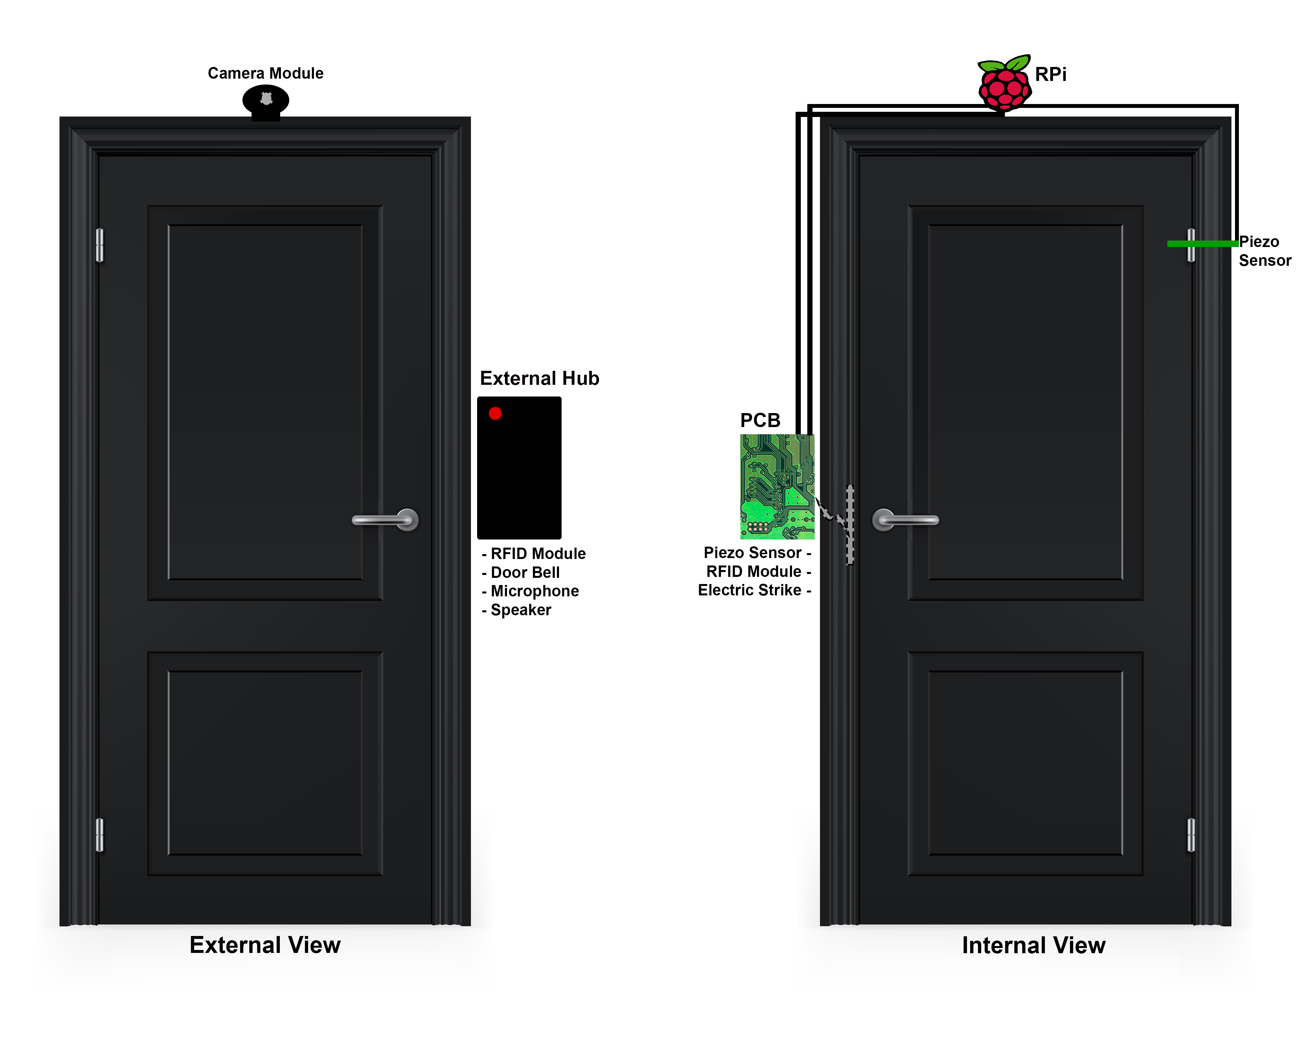
Model

Slide 53
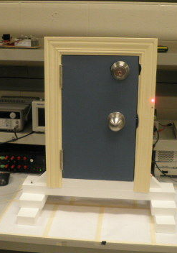
Prototyping

Slide 54
Budget
Item | Cost
AC/DC Adapter | $20
Raspberry Pi | $35
ATMega328 | $20
WiFi Module | $15
Electric Strike | $30
Pi Camera Module | $30
RFID Module | $30
PCB | ~ $50
Battery Backup | ~ $20
Piezo Element | $5
USB Sound Card | $15
Speaker & Microphone | $12
Item | Cost
Prototyping Materials | ~$30
Various Electronic Parts | ~$20
NiMH Batteries | $18
Total | ~$350

Slide 55
Work Distribution
 | Chris | Jason | Josh | Sam
ATMega328 | X | X
Knock Pattern | X | X
Face Recognition |  |  | X
RPi Software |  |  | X | X
Android App |  |  | X | X
Server / UI |  |  |  | X
Power | X
RFID |  | X

Slide 56
Progress

Slide 57
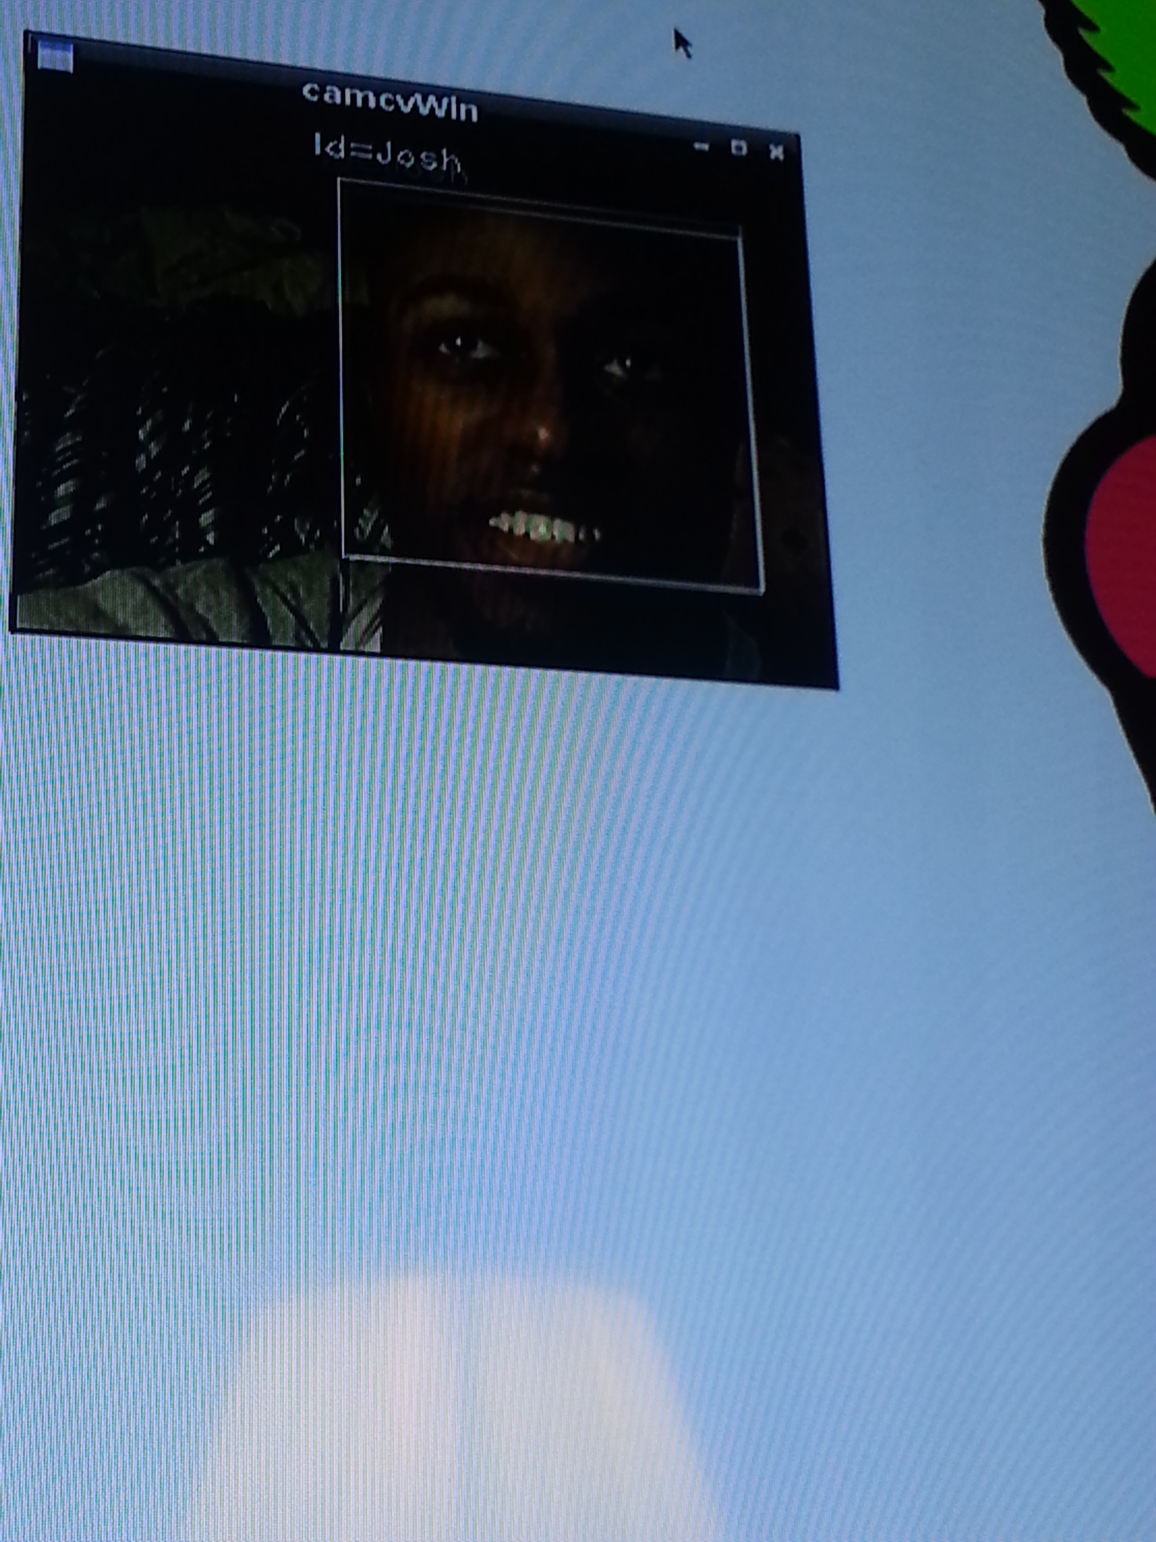
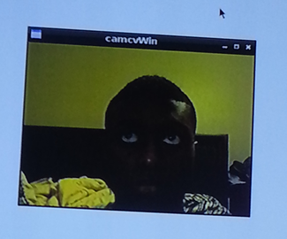
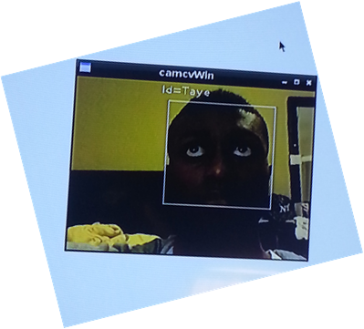
Issues
Piezo Placement/Sensitivity
Face Detection and Face Recognition
Integration
Battery Backup

Slide 58
Questions?
Notes:
add picture ?

